Slide 1




P-11: REMINDER AND TASK SCHEDULER
Team: ASAN
NEELABH RANA(202301476)
SOHAM MEVADA (202301484)
ATIK VOHRA (202301447)
AKSHAT BHATT (202301460)

Slide 2
“STAY ON TOP
OF YOUR TASK WITH
EASE”

Slide 3
P-11. REMINDER AND TASK MANAGER
Create an application that manages tasks and schedules using data structures to prioritize and track tasks based on deadlines or importance levels. It should also have reminder functionality as the deadline is approaching.

Slide 4
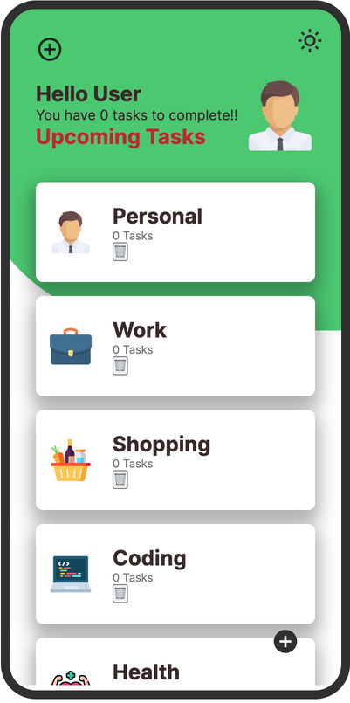

Solution:
We have made console based app(using CPP) and a
Graphiclal User Interface
(using HTML,CSS,JS).To solve the core problem of task i.e. rescheduling and reminder we have used Data Structures and used some algorithms to come up with the final solution.
Now lets dive into the Algorithms ....

Slide 5
ALGORITHM
We have used Doubly Linkes List for arrangement of tasks in systematic and required way...
Once the Program is terminated the data given by the user is not erased but it is rather stored in file using the concept of file writing.
The content of the files are rewritten into the corresponding
linked list every time the code is run.

Slide 6
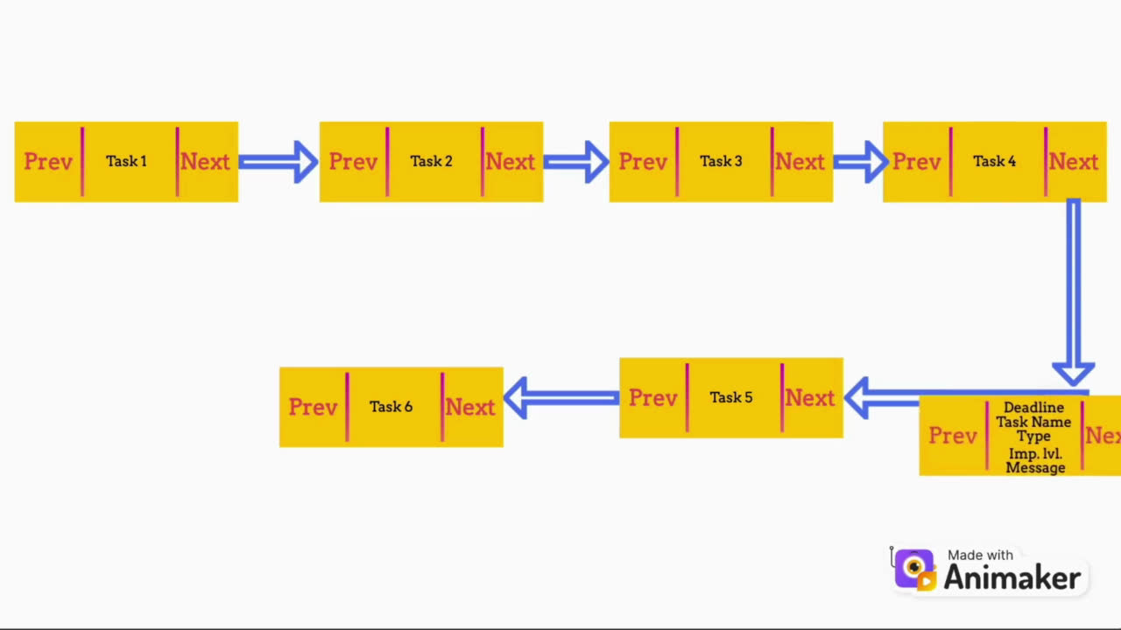
ALGORITHM
The program is made completely dependent on user responses.
For the insertion of task, valid input data is taken and then a Node is made
which is then inserted in the list as shown in the clip below.
Time complexity of insertion: O(n)
Space complexity of insertion: O(1)
(where n=number of nodes in the list.)

Slide 7
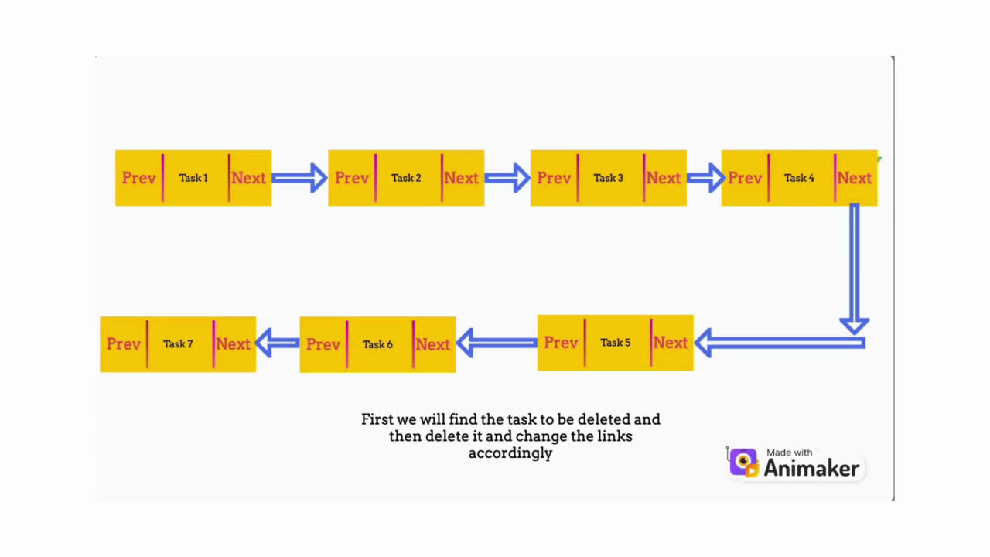
ALGORITHM
If we want to delete a particular task then we will search through the list and find the task and make required changes for the deletion of the task(Node).
Time complexity of deletion: O(n)
Space complexity of deletion: O(1)
(where n=number of nodes in the list.)

Slide 8
ALGORITHM
We have made a reminder function which scans the task within 12hrs and reminds the tasks coming within that time period.
The time period reminder i.e. 12 hr. can be changed just by changing the value given in the function call statement of reminder function in the main function.

Slide 9
ALTERNATE ALGORITHM
We have made another implementation which uses hash tables instead of linked lists , the main purpose for this is to change the time complexity of insertion and deletion from O(n) to O(1).
There is a function which calculates a specific value or key for each entry of date, time , priority which is also known hash function. According to the hash value , the file is stored inside the system‘s memory and which has the address of the hash value created.

Slide 10
ALTERNATE ALGORITHM
Insertion time complexity:- O(1)
Insertion space complexity:- O(1)
(as the file is created in constant time in the system)
(See image for visualisation)

Slide 11
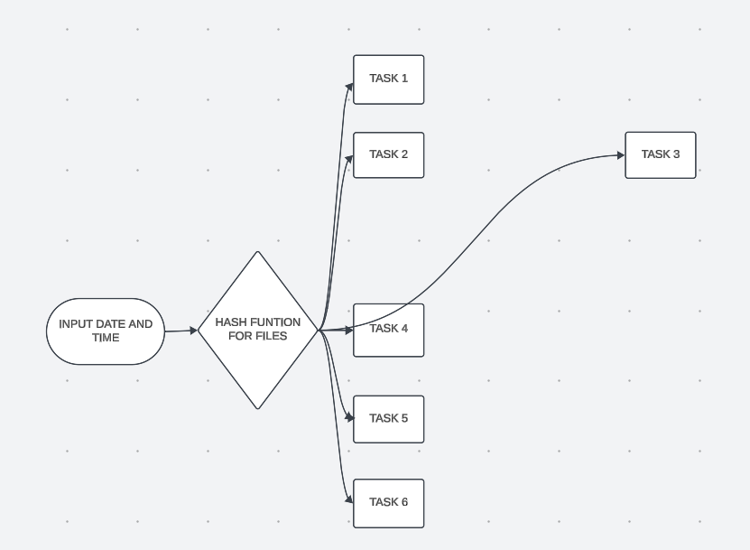
INSERTION OF TASK 3 IN THE HASH TABLE

Slide 12
ALTERNATE ALGORITHM
Deletion time complexity:- O(1)
Deletion space complexity:- O(1)
(as the file is deletd in constant time in the system)
See image for visualisation

Slide 13
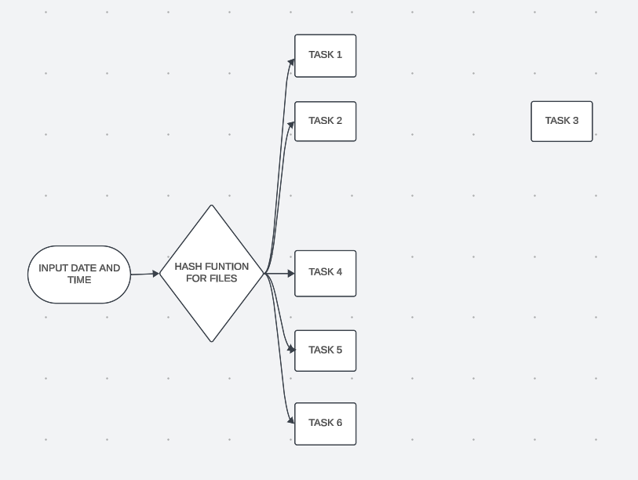
The access to the pointer is released from task 3 , thus it is deleted

Slide 14
SUMMARY
The insertion and deletion functions are used heavily in the defination of other functions which contriute a major chunk in the
implementation of various functionalities.
This were the main algorithm of oursolution and for further detailed information of each function, please refer to the Document attached below.
Link: Document

Slide 15
SOME KEY FEATURES WE ADDED:
Username and password
Uniqueness of Usernames
Daily Task Segment
Editing Task(Every field of task including Rescheduling)
Maintaining Data even after code is Terminated
Display of Incomplete Daily Task
Deletion of Whole tasks list
Use of Switch cases to increase interaction with the user

Slide 16
REGARDING GUI:
We have made a GUI using HTML,CSS and javascript which is made
considering mobile usage .
Link To GUI: https: //atikdagu.github.io/todoweb/

Slide 17
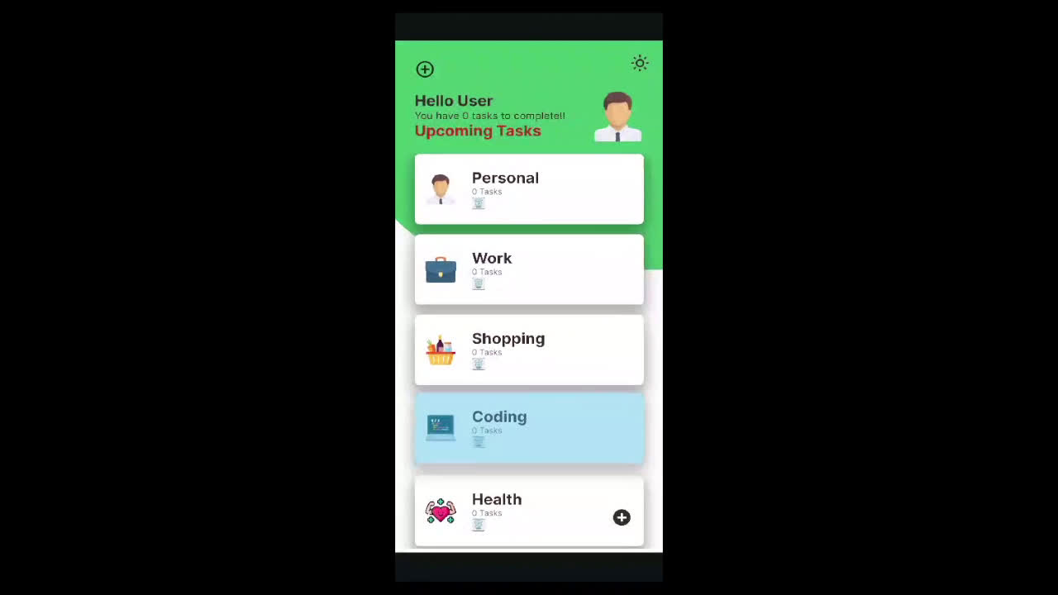
Short Clip of
our GUI

Slide 18
VOICE OVER VIDEO
Link: Voice Over Video

Slide 19
THANK YOU

